Slide 1
PRACTICE EXAM/ STUDY GUIDE 3

Slide 2
UNIT V: POPULATIONS
Lecture 15: Population Ecology
a. Define population and describe the size, density and distribution of populations.
b. define birth rate, death rate, growth rate, total fertility rate, infant , mortality rate, environmental resistance, carrying capacity, exponential growth, and biotic potential and explain how they interact to affect
populations.
c. compare density dependent to density independent factors

Slide 3
Lecture 16: Human Population
a. Compare demographics in MDC’s and LDC’s. Explain how demographics can be used to predict trends In population growth
b. Describe human population growth, cultural changes and how humans have affected the environment throughout history.
c. Compare resource consumption overpopulation to numbers over-population and their impact on the environment (IPAT).
d. Describe the role played by urbanization in the population crisis.
e. Explain how age structure, TFR, and marriage age interact to affect human population size.
f. Describe the demographic transition model and explain how human population can be controlled.

Slide 4
Demographics = ________
Who was the “father” of demographics?

Slide 5
Demographics =
study of statistical change in human populations
birth rate, death rate, TFR, marriage age, etc.
Malthus was the “father” of demographics

Slide 6
What type of growth curve does the world human population have?

Slide 7
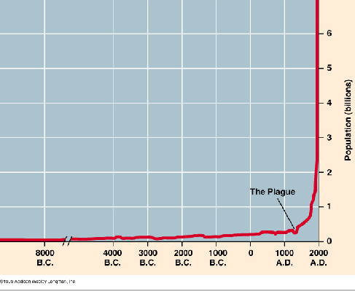
J-shaped/exponential growth curve

Slide 8
What are the 3 factors that interact to cause environmental impact?

Slide 9
3 factors interact to cause environmental impact:
I = P x A x T
Impact = Population x Affluence x Technology

Slide 10
Where will most human population growth occur in the next 50 years?
MDC’s or LDC’s?
Which continents will have the greatest growth rate?
How do we calculate growth rate?

Slide 11
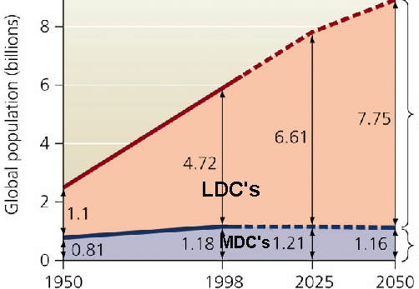
Most growth in LDC’s
The continent with the highest growth rate is Africa.
Growth rate = (birth rate + immigration) – (death rate + emigration)

Slide 12
environmental resistance = ________________________
What factors did Malthus predict will limit human population growth?

Slide 13
environmental resistance = all factors that reduce population growth
What factors did Malthus predict will limit human population growth?
War, pestilence (disease) and famine
(Lack of clean, fresh water will probably be the greatest limiting factor)

Slide 14
carrying capacity =
total fertility rate =
marriage age =
infant mortality rate =
world growth rate =

Slide 15
carrying capacity = # of individuals of a species that can be sustained indefinitely in an area
total fertility rate =
total # babies/woman
marriage age = age a woman has her 1st baby
infant mortality rate = # of babies that die before 1st birthday/1,000
world growth rate = birth rate - death rate

Slide 16
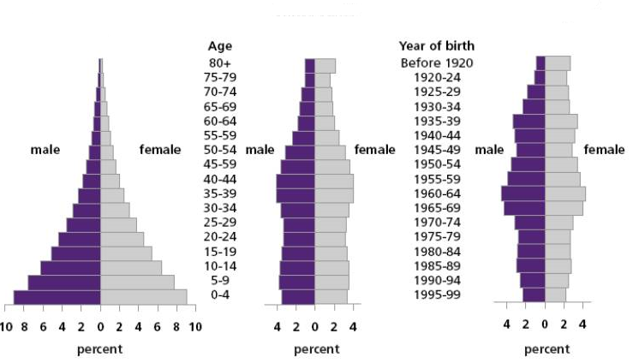
Use the age structure diagrams to predict population growth in the 3 countries.

Slide 17
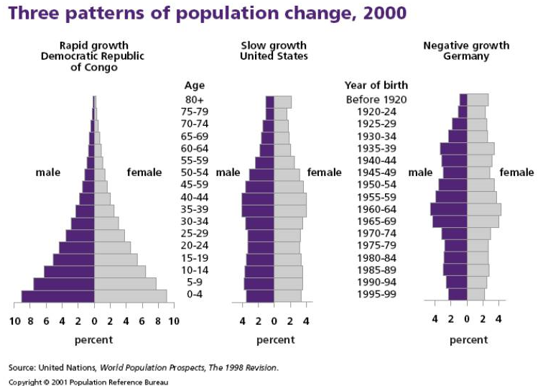

Slide 18
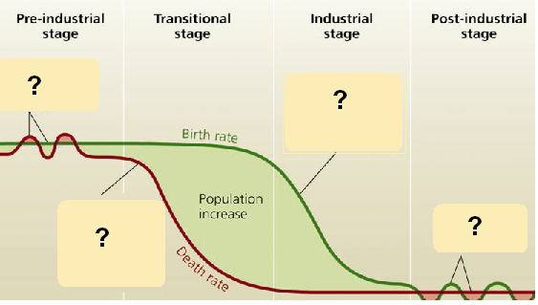
Explain what is happening with birth rate, death rate and growth rate at each stage of the demographic transition model
What is the most important factor in the declining growth rate during the industrial and post-industrial stages?

Slide 19
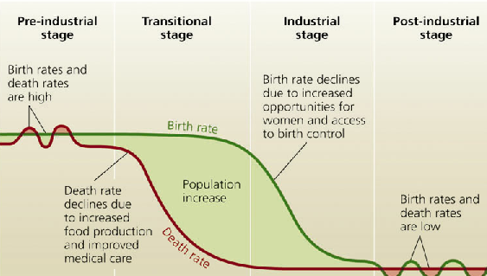
The most important factor in the declining growth rate during the industrial and post-industrial stages is an increase in education of women and improvement in their socioeconomic status. This causes a lower TFR, declining birth rate and declining growth rate.

Slide 20
UNIT VI: FOOD RESOURCES
Lecture 17: Soil
a. Describe components, structure, and physical properties of soil.
b. Classify soil as a resource and describe its formation. Is soil renewable or non-renewable?
c. Define soil profile, horizon, humus, leaching.
d. Examine the community of organisms in soil and correlate their diversity with nutrient levels and organic components in soil. What is at the base of the soil food chain?
e. Describe problems with soil in US and world.

Slide 21
f. Define erosion and list factors that affect the rate of erosion.
g. Review types of soil pollution and their relationship to water pollution.
h. List ways to conserve and regenerate soil

Slide 22
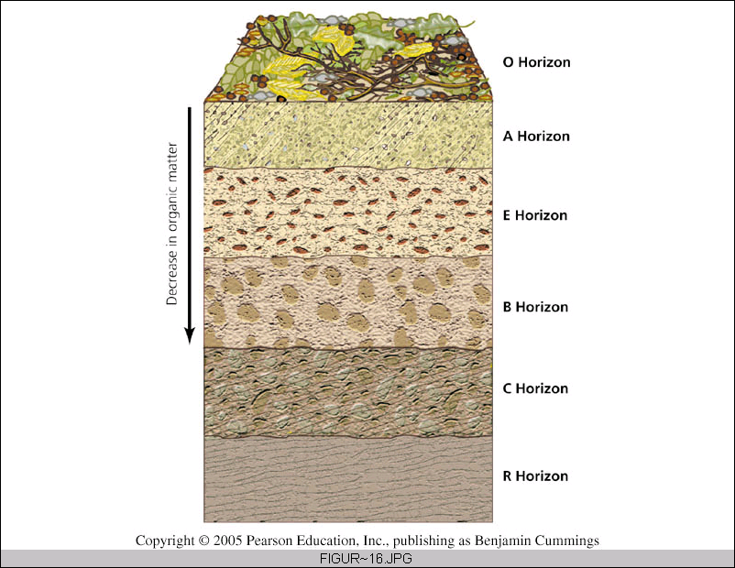
Which horizon has the most organic matter?

Slide 23
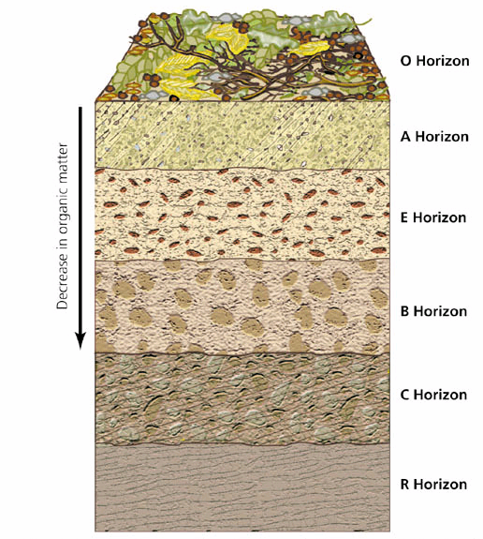
Horizons = layers in profile
O= Surface with OM
A = topsoil
E = zone of leaching
B = subsoil
C = parent material
R = bedrock

Slide 24
Which soil texture(s) are optimal for plant growth?
What is the biggest soil problem?

Slide 25
Which soil texture(s) are optimal for plant growth? silt and loam
TEXTURE | DRAINAGE | WATER HOLDING | AERATION | WORKABILITY | NUTRIENT HOLDING
SAND | GOOD | POOR | GOOD | GOOD | POOR
SILT | MED | MED | MED | MED | MED
CLAY | POOR | GOOD | POOR | POOR “TERRIBLE” | GOOD
LOAM | MED | MED | MED | MED | MED

Slide 26
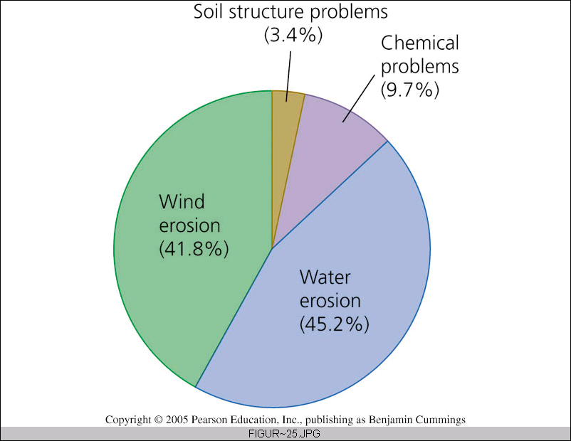
What is the biggest soil problem? erosion

Slide 27
Lecture 18/19: Agriculture and Food Resources
Describe human nutritional requirements.
What are the 6 types of nutrients and why do we need each?
b. What is food security? Describe world food problems and identify their causes. Define undernourishment, malnourishment, marasmus, kwashiorkor, and overnutrition.
c. Examine the history of agriculture and its impact on the environment.

Slide 28
d. Compare subsistence agriculture, plantation agriculture, industrialized agriculture, and sustainable agriculture.
What does each type of agriculture use for energy?….fertilizer? How does each kill pests? Which one(s) grow a monoculture?…polyculture? Which is most productive?

Slide 29
Lecture 20: Biotechnology and the Future of Food
a. Explain how humans have artificially selected characteristics of organisms in the past.
b. Define gene, nucleotide, mutation.
c. Describe the building blocks and structure of DNA.
d. Explain how DNA determines an organism’s characteristics.
e. Define genetic engineering. Discuss the pros and cons and explain why genetic engineering is an environmental concern.
f. Explain why it is important to preserve crop diversity.

Slide 30
Use the strand of DNA to determine the complementary strand of DNA:
T AGGAAG C T

Slide 31
TAGGAAGCT
AT CCTTC GA

Slide 32
Use the strand of DNA to determine the RNA that would be transcribed:
T AGGAAGC T

Slide 33
Use the strand of DNA to determine the RNA that would be transcribed:
TAGGAAGC T
AUCCUUC G A

Slide 34
The building blocks of DNA are ____
The building blocks of proteins are ___
The process of using the mRNA to build a polypeptide (protein) is ____

Slide 35
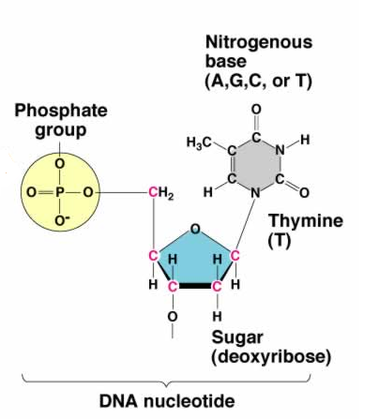
The building blocks of DNA are nucleotides
The building blocks of proteins are amino acids
The process of using the mRNA to build a polypeptide (protein) is translation

Slide 36
Lecture 21: Toxicology and Pest Management
a. Define pest and pesticide.
b. Describe types of pesticides and some of their problems. What is persistence?
c. Review the cycling of matter through a food chain and explain why biological amplification occurs.

Slide 37
IPM = _____
Why is DDT considered to be an environmentally destructive pesticide?
Explain how pesticides have caused evolution of resistant organisms.

Slide 38
IPM = Integrated Pest Management
Why is DDT considered to be an environmentally destructive pesticide? Persists for years and causes biological amplification

Slide 39
Explain how pesticides have caused evolution of resistant organisms.
There is genetic variation in a population of pests. When pesticide is applied, most die but a few are genetically resistant, survive, and pass on their resistant genes. Soon, the whole population is resistant to the pesticide.

